Slide 1
Free Quality Kindergarten Education Scheme Briefing Session on Rental Subsidy
Education Bureau
March 2017

Slide 2
Key
Abbreviation | Description
KGs : | Kindergartens, kindergarten-cum-child care centres and schools with kindergarten classes
Scheme : | Free Quality Kindergarten Education Scheme
Scheme-KGs : | KGs approved to join the “Scheme”
RSS : | Rental Subsidy Scheme
E-Application : | Electronic platform for RSS under the “Scheme”
RSS Guide: | Procedural Guide on E-Application for Rental Subsidy under the RSS
TA: | Tenancy Agreement

Slide 3
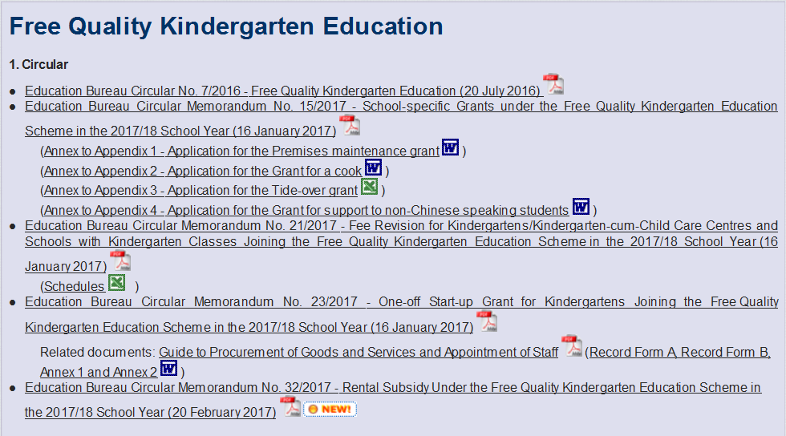
EDBCM No. 32/2017
http://www.edb.gov.hk/: Home > Education System and Policy > Kindergarten Education > Free Quality Kindergarten Education

Slide 4
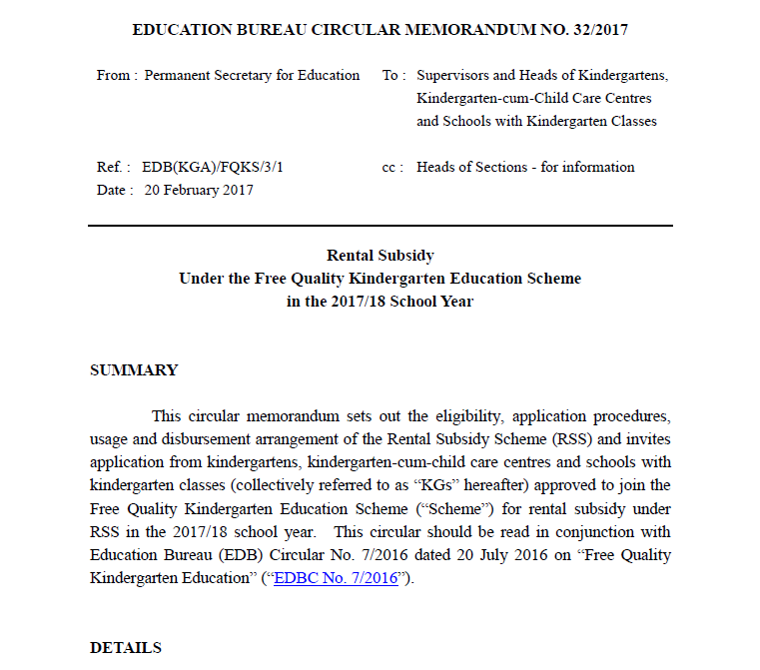

Slide 5
Rental Subsidy Scheme
KGs joining Free Quality Kindergarten Education Scheme will be provided rental subsidy under RSS so as to lessen KGs’ rental-related financial burden.
A scheme-KG having no rental expenditure or not paying rent under tenancy agreement (TA) should / need not apply for rental subsidy.

Slide 6
1. Eligibility
- Para. 3 of EDBCM 32/2017
- Para. 7.1 of RSS Guide
Only KGs approved to join the Scheme
Operating in rented premises under TAs
Only rental of the KG portion
for the school premises
✓
✓
✓

Slide 7
1. Eligibility Scheme-KGs can only be eligible for either rental subsidy or premises maintenance grant for the school premises concerned.
Rental Subsidy
Premises Maintenance Grant

Slide 8
2. Usage
All Scheme-KGs should spend the rental subsidy solely on rental expenditure for the KG section/classes offering local curriculum.
Any non-school portion should not be included.

Slide 9
3. Accounting Arrangement
Scheme-KGs are required to maintain separate ledger accounts to record rental subsidy and rental expenditure, and report these income and expenditure in their annual audited accounts to be submitted to EDB.

Slide 10
3. Accounting Arrangement
Documents such as TAs and rental receipts should be kept at schools for a period of not less than 7 years and made available to EDB when requested.
Any unspent balance of the rental subsidy based on annual audited accounts will be clawed back by EDB.

Slide 11
Different Categories of
Eligible Scheme-KGs under RSS
Nominated Estate KGs
Other KGs under-Grace-Period
Other KGs
Different Amount of Rental Subsidy
Full rental subsidy subject to fill-up rate
“Dual” Cap

Slide 12
Different Categorization of Eligible Scheme-KGs under RSS
Nominated Estate KGs
the premises have been allocated under the EDB-administered school allocation or nomination mechanisms; and
the monthly rentals payable in respect of the said premises are at concessionary rate as assessed by the Hong Kong Housing Authority (around 50% of market rent) and stipulated in the TAs
only the registered school premises under the school location of the KGs having met the above two conditions of operating in housing estates will be eligible for full rental subsidy subject to the fill-up rate.
Other registered premises under the same school location but have not met the conditions mentioned above are not eligible for rental subsidy under RSS.

Slide 13
Different Categorization of Eligible Scheme-KGs under RSS
Other KGs
(not include former aided child care centres under SWD before Harmonisation in 2005)
For other KGs, the rental subsidy will be subject to “dual” caps :
50% of open market rental as assessed by RVD, or
15% of the “basic half-day (HD) unit subsidy” for all eligible students
whichever is lower.

Slide 14
Different Categorization of Eligible Scheme-KGs under RSS
Other KGs under-Grace-Period
For individual Scheme-KGs which are currently paying market rent and receiving rental subsidy under the Rent Reimbursement Scheme, their current rented premises will continue to receive the current subsidy for a grace period of four years from the 2017/18 to 2020/21 school years.
During the grace period, the amount of rental subsidy will be the full rental amount as stipulated in the TA; or
the market rent as assessed by RVD,
whichever is lower, subject to the same set of fill-up rates
Other registered school premises under the same school location will not be eligible for any rental subsidy under RSS.

Slide 15
Different Categorization of Eligible Scheme-KGs under RSS
Starting from the 2021/22 school year, these KGs will be under the “dual” caps as “Other KGs”.
Should individual KGs be eligible for the grace period arrangement, but wish to be covered under the “dual” caps with effect from the 2017/18 school year, they should complete and return Appendix 1 to EDB on or before 27 March 2017 (Monday).

Slide 16
Different Categorization of Eligible Scheme-KGs under RSS
For former aided child care centres under SWD before Harmonisation in 2005, they will continue to be eligible for full rental subsidy.

Slide 17
Calculation of Rental Subsidy
The amount of rental subsidy disbursed to different categories of eligible Scheme-KGs under RSS is determined by the：
fill-up rate
“dual” caps
market rent as assessed by RVD

Slide 18
Calculation of Rental Subsidy
apportionment of rental expenditure between
sections (KG and child-care-centre (CCC) classes)
streams (local and non-local curriculum)
school portion and non-school portion
eligible and non-eligible students under the Scheme

Slide 19
Calculation of Rental Subsidy
Fill-up rate：
(For Nominated Estate KGs and Other KGs under-Grace-Period)
The number of students in the KG in the morning session or in the afternoon session whichever the higher | × 100%
total permitted accommodation (P.A.) as stated on the Accommodation Certificate
Fill-up Rate | Rental Subsidy
50% or above | Full
25% to <50% | 50%
<25% | 25%

Slide 20
Calculation of Rental Subsidy
New Nominated Estate KGs will be eligible for full rental subsidy in the first three-year TA regardless of their fill-up rate.

Slide 21
Calculation of Rental Subsidy
For a classroom taking up both WD and HD KG students (i.e. combined class), the larger P.A. (i.e. HD P.A.) of that classroom will be counted;
As a special concession for the purpose of calculating the fill-up rate:
For a classroom with P.A. larger than 30 however with ≤30 KG students (including combined class) accommodated there at any one session, the P.A. of that classroom can be counted as 30. Otherwise, the actual P.A. of that classroom as shown on the Accommodation Certificate should be used.

Slide 22
Calculation of Rental Subsidy
For a vacant classroom, the lower P.A. will be counted. For a vacant classroom with more than 30 P.A., 30 will be counted.
For a dual registered activity room /classroom for the use of both the KG and CCC sections, if any, the morning or the afternoon session with the higher enrolment of KG students accommodated there, the total number of which will be taken as the P.A. counted.

Slide 23
Calculation of Rental Subsidy
If a classroom/activity room is dually registered, but is only occupied by CCC children, the P.A. of that room will not be counted.

Slide 24
Calculation of Rental Subsidy
“Dual” caps: (applicable to “Other Kgs”)
The amount of rental subsidy would be:
half of the rental amount as stipulated in the TA or half of the market rent as assessed by RVD, whichever is lower；Or
the amount of 15% of the basic HD unit subsidy per student per annum multiplying the total number of eligible students under the Scheme15%
The basic HD unit subsidy in the 2017/18 school year shall be $33,190 per student per annum (pspa), the 15% of which is $33,190 x 15% = $4,979 pspa.

Slide 25
Calculation of Rental Subsidy
the market rent as assessed by RVD (if applicable)

Slide 26
Calculation of Rental Subsidy
(4) Apportionment of rental expenditure
Sections (KG & CCC classes)
School portion & non-school portion
Streams (local & non-local curriculum)
eligible and non-eligible students

Slide 27
Calculation of Rental Subsidy
Apportionment of rental expenditure:
For eligible Scheme-KGs operating both KG and CCC classes, apportionment is based on the ratio below:
For eligible Scheme-KGs operating both local and non-local streams, apportionment is based on the ratio below:
Total number of KG enrolments | × 100%
Total number pf enrolments of the whole KG-cum-CCC
Total number of enrolments of local stream | × 100%
Total number of KG enrolments of the whole KG

Slide 28
Calculation of Rental Subsidy
Only school portion (i.e. the portion of the school area registered as KG/KG-cum-CCC) is eligible for rental subsidy. Should the rental amount as stated in the TA cover both the school portion and non-school portion (such as the church, primary school or secondary school), apportioning the rental amount to be shared by school and non-school portion by RVD may be required.
For eligible and ineligible students under the Scheme, apportionment is based on the proportion of the eligible KG enrolments towards that of the whole KG/KG section.

Slide 29
Worked examples on the calculation of rental subsidy
Worked examples on the calculation of rental subsidy for different categories of eligible Scheme-KGs under RSS are provided at Appendix 4 of “Procedural Guide on E-Application for Rental Subsidy under the Rental Subsidy Scheme (2017/18)”

Slide 30
“Procedural Guide on E-Application for Rental Subsidy
under the Rental Subsidy Scheme”
Through School Portal
https://fkg.edb.gov.hk

Slide 31
“Procedural Guide on E-Application for Rental Subsidy
under the Rental Subsidy”
Through the School Portal Account, KGs can:
Download the “Procedural Guide on E-Application for Rental Subsidy under the Rental Subsidy Scheme” and submit applications for rental subsidy
Click to expend the item “Rental Subsidy Scheme” on the menu bar after the login is successful.

Slide 32
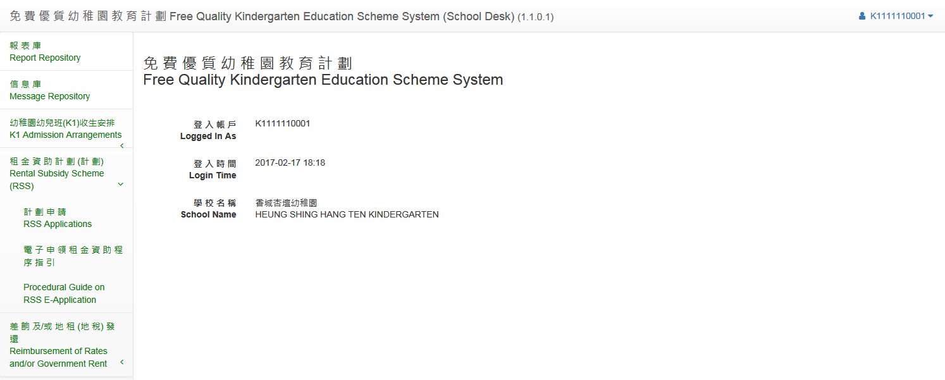
“Procedural Guide on E-Application for Rental Subsidy
under the Rental Subsidy Scheme”
Select “Procedural Guide on RSS E-Application” on the drop-down menu.
The procedure guide will be opened directly by browser in PDF format which may be downloaded and printed.

Slide 33
APPLICATION PROCEDURES
E-Application
Eligible Scheme-KGs should follow the procedures illustrated at the RSS Guide for submission of applications (referred as “E-Application”) for rental subsidy through the School Portal Account(https://fkg.edb.gov.hk).
Print and Sign
print out the whole set of duly completed schedules from the School Portal Account and sign the schedule form(s) and
Submit printed applications with necessary documents
submit their printed applications and signed schedule form(s) to their respective Senior School Development Officers or Senior Services Officers (SDOs/ServOs) together with (i) TA; and (ii) documentary evidence provided by the landlord/grantee, indicating that the property/site can be let/sublet for rental purposes (for example, the site is designated for religious/community purposes).

Slide 34
APPLICATION PROCEDURES
Documentary evidence provided by the landlord/grantee, indicating that the property/site can be let/sublet for rental purposes (for example, the site is designated for religious/community purposes) for:
those rented premises which are NOT housed in public housing estates under the Hong Kong Housing Authority (“HKHA”) /The LINK Real Estate Investment Trust ("LINK"); Hong Kong Housing Society (“HKHS”), private mass housing or commercial shopping malls and other private premises such as residential building, commercial building, tenement houses, etc.

Slide 35
APPLICATION PROCEDURES
Submission of application in hard copy which is NOT prepared and printed through the School Portal Account will not be accepted.
Rental subsidy application should be submitted to KGs' respective Senior School Development Officers or Senior Services Officers (SSDOs/SServOs) on or before 31 March 2017 (Friday).

Slide 36
APPLICATION PROCEDURES
KGs currently under Rent Reimbursement Scheme
Former aided child care centres under the Social Welfare Department
Nominated Estate KGs/Other KGs under-Grace-Period
have to submit fresh applications for joining RSS
follow the existing procedures for rent reimbursement, hence need not apply for joining RSS

Slide 37
APPLICATION PROCEDURES
The amount of rental subsidy disbursed to each eligible Scheme-KG is based on the school registration by each registered school location enrolled with KG students.
For Scheme-KGs :
with one registered school location enrolled with KG students; and
under one TA,
one application should be submitted.

Slide 38
APPLICATION PROCEDURES
For Scheme-KGs :
with more than one registered school locations enrolled with KG students
with separate TAs,
separate applications for each location should be submitted.

Slide 39
APPLICATION PROCEDURES
For Scheme-KGs：
with more than one registered school locations enrolled with KG students and
having all or some school locations under the same tenancy agreement
one application should be submitted for the school locations under the same TA.

Slide 40
APPLICATION PROCEDURES
Before KG submitting E-Application, REO/JOKC will confirm with KG which registered location would be the primary location. KG should use the location number of the primary location to submit its E-Application to avoid duplicate submission.
The classroom information of both locations would all be combined into the primary location.

Slide 41
APPLICATION PROCEDURES
For a KG-cum-CCC having common shared areas for KG and CCC sections within the registered school location of KG section and under separate TAs for KG and CCC sections, advice from respective School Development Officer/Services Officer on provision of TA information for E-Application should be sought.

Slide 42
APPLICATION PROCEDURES
Likewise, for Scheme-KGs having registered with one school location enrolled with KG students but with separate TAs for different registered premises under the same school location, advice from respective School Development Officer/Services Officer on provision of TA information for E-Application should be sought.

Slide 43
Disbursement Arrangement
To tie in with the commencement of the school year of individual Scheme-KGs, rental subsidy will be disbursed on a monthly basis from August or September.
The provisional amount of rental subsidy from August or September to December will be released on the basis of the projected enrolment as of September.
August
September

Slide 44
Disbursement Arrangement
EDB would verify the actual enrolment as of September of the school year concerned (if applicable):
the actual enrolment of eligible and ineligible students under the Scheme
the actual enrolment of local and non-local stream
the actual enrolment of the KG and CCC section

Slide 45
Disbursement Arrangement
After verification, the amount of “Confirmed Rental Subsidy” for the whole of the school year would be calculated and released in January and subsequent months of the school year.
Underpayment of rental subsidy for the months of August/September to December would be settled in January, whereas overpayment of rental subsidy would be deducted from the upcoming rental subsidy in January and subsequent months, if required of the school year concerned.

Slide 46
RSS Period and the Rental Period of the TA
The approval for an application shall be granted on a yearly basis.
The amount of rental subsidy, calculated on a yearly basis, for individual eligible Scheme-KGs is disbursed monthly and covers the period from the commencement and up to the end month of the school year concerned of individual Scheme-KGs (i.e. from 1 August/September to 31 July/August) (referred as “RSS Period”)
The amount of rental subsidy subject to application for change in the amount of rental subsidy pursuant to new TA.

Slide 47
RSS Period and the Rental Period of the TA
The rental period of the TA should cover wholly or partly the RSS period of the school year concerned for E-Application.
If not, these eligible Scheme-KGs can provide the rental particulars of the current TA (referred to as “To-be-Expired Tenancy Agreement”) but in parallel they should negotiate with the landlord in good time for a new TA covering wholly or partly the RSS period of the school year concerned and take the following actions as and when required:

Slide 48
RSS Period and the Rental Period of the TA
These eligible Scheme-KGs should keep their respective School Development Officer / Services Officer informed of the progress of the signing of the new TA.
If the E-Application has been duly submitted and approved before the availability of the new TA, a “Temporary Rental Subsidy” would be disbursed instead of “Provisional Rental Subsidy”.

Slide 49
RSS Period and the Rental Period of the TA
When the new TA is available, concerned eligible Scheme-KGs should submitted E-Application for change in the amount of rental subsidy pursuant to new TA.

Slide 50
RSS Period and the Rental Period of the TA
If the new TA covering wholly or partly the RSS period of the school year has been signed before the “Temporary Rental Subsidy” is approved, a Scheme-KG should:
contact their respective SDOs/ServOs to request for returning the application
update TA information
re-submit the application

Slide 51
E-application
As the calculation of rental subsidy will be subject to fill-up rate, “dual” caps, and apportionment for the Scheme-KG section, CCC section and/or section offering non-local curriculum, to facilitate Scheme-KGs’ submission of the information, a Rental Subsidy Scheme System (“RSS System”) has been developed.
Eligible Scheme-KGs should follow the procedures illustrated at the RSS Guide for submission of applications for rental subsidy through the School Portal Account (referred as “E-Application”).
Submission of application in hard copy which is NOT prepared and printed through the School Portal Account will not be accepted.

Slide 52
E-application
Applicant Scheme-KGs have to input all the required information.
the rental related information (e.g. the validity period of the TA, the monthly rental)
rental period (from day/month/year to day/month/year);
rent-free period, if applicable (from day/month/year to day/month/year);
monthly rental in TA;
whether the monthly rental as stated in TA covering school and non-school portion; and
monthly rental for school portion

Slide 53
E-application
The system will provide appropriate schedules for each application based on the information of individual KG stored in the system.
There is no need for KGs to choose which schedules to fill in.

Slide 54
E-application (Schedule 1)
Declaration of School Supervisor of KG
whether the KG has been granted approval for joining the Scheme; and
whether the KG is currently in receipt of rental subsidy under the existing Rent Reimbursement Scheme

Slide 55
E-application (Schedule 2)
Eligible Scheme-KGs are required to provide the estimated enrolment as of September of the school year for the KG section (if applicable)
by level [i.e. nursery (K1), lower KG (K2) and upper KG (K3) classes)];
by session [i.e. AM, PM and whole-day (WD)];
by stream (local and non-local curriculum);
estimated enrolment for the CCC section

Slide 56
E-application (Schedule 2)
Provision of enrolment information in Schedule 2 based on admission of the students should be strictly in accordance with the approved permitted accommodation (P.A.) of each classroom.
The classroom designation and the corresponding P.A. information is obtained from the Certificate of Accommodation of individual KGs and entered in the relevant sections of Schedule 2.

Slide 57
E-application (Schedule 2)
KGs should check the P.A. information therein against its Certificate of Accommodation.
If it is found that there are discrepancies between the pre-filled information and the information on its Certificate of Accommodation, KGs should contact their respective SDOs/ServOs for revising the P.A. information stored in the system, if required.

Slide 58
E-application (Schedule 2)
Provision of enrolment information based on admission of the students should be strictly in accordance with the approved permitted accommodation (P.A.) of each classroom.
✓ Reporting enrolment of both AM & WD students in the same
classroom would be accepted;
✗ Reporting enrolment of both PM & WD students in the same
classroom would NOT be accepted.
✓ Reporting students of different levels (i.e. K1, K2 & K3)
in the same classroom in any session would be accepted.

Slide 59
E-application (Schedule 3)
Rental particulars for
KG premises that are paying open market rent; and
requiring rental assessment by RVD → Schedule 3 should be filled in.

Slide 60
E-application (Schedule 3)
Rental Assessment by RVD:
RVD rental assessment is required for eligible Scheme-KGs whose premises are NOT rented from the Hong Kong Housing Authority or are NOT “rental housing”/“rural public housing” rented from the Hong Kong Housing Society.
The open market rental as assessed by RVD (including those assessment made before the implementation of the Scheme) would be used in the calculation of rental subsidy under RSS and school fees for the whole rental period of the TA. RVD rental assessment would then be required only when there is a new TA.

Slide 61
Tie-in with Fee Revision
For fee revision application of the school year concerned, eligible Scheme-KGs should:
employ the same set of estimated enrolment information provided in Schedule 2 for E-Application of Rental Subsidy
reflect the same estimated rental subsidy in the relevant schedules for fee revision application of the school year concerned

Slide 62
Tie-in with Fee Revision
The estimated amount of rental subsidy would be computed by the RSS system through E-application. KGs should fill this amount in their fee revision applications.

Slide 63
Tie-in with Fee Revision
The approved amount of rental subsidy will be stated in the approval letters issued by EDB.

Slide 64
Tie-in with Fee Revision
The amount of actual rental expenditure on top of the amount of rental subsidy received that will/will not be recognised for fee revision assessment for the KG section is summarized as follows:
Whether recognised for fee revision assessment for KG section |  | Remarks
The difference between actual rental expenditure and the rental subsidy due to:
(i) Fill-up rate | ✓ | The different between the actual rental expenditure and the rental subsidy can be charged to the subsidies under the KG scheme and/or school funds.
(ii) “Dual” Caps | ✓
(iii) Apportionment of rental expenditure |  | The amount of rental expenditure to be borne by CCC section/non-local stream should be charged to the respective section/stream for fee revision assessment.
(iv) The difference between actual rental expenditure and the rental amount as assessed by RVD |  | The amount of actual rental expenditure not recognising for fee revision should not be charged to the subsidies under the KG Scheme. It should be borne by school funds (except school fees).

Slide 65
“Returned” of E-Application
If eligible Scheme-KGs consider necessary to revise some information after successful submission of the E-Application, they should contact their respective SDOs/ServOs to make a request for them to “Return” the application for revisions.
If the applications require modification, SDOs/ServOs may also, when necessary, returns them to KGs for amendments.

Slide 66
“Returned” of E-Application
If the new TA is available before the application of “Temporary Rental Subsidy” is approved, the application will also be returned to KG for re-submission of the application with updated tenancy information.
KGs should log into the system to make corresponding changes and re-submit the applications.

Slide 67
New Tenancy Agreement
New TA should be submitted, preferably three to six months before it commences for processing of rental subsidy renewal.
The amount of rental to be released will be subject to the rental as assessed by RVD, if required.
Any delay in submitting the new TA may result in payment of rental subsidy being temporarily suspended.

Slide 68
New Tenancy Agreement
Eligible Scheme-KGs under RSS are required to submit E-Application for change in the amount of rental subsidy pursuant to the new TA irrespective of whether or not there are any changes in the rental amount through the School Portal Account (at https://fkg.edb.gov.hk).

Slide 69
E-Application for New Tenancy Agreement
Eligible Scheme-KGs should:
input all the required information;
follow through the procedures to print out the whole set of duly completed schedules from the School Portal Account;
sign the schedule form(s) and
submit their printed applications to their respective SSDOs or SServOs together with a copy of the new TA.

Slide 70
E-Application for New Tenancy Agreement
Eligible Scheme-KGs are required to provide the following rental related information for E-Application for New TA:
New TA information
rental period (from day/month/year to day/month/year);
rent-free period, if applicable (from day/month/year to day/month/year) ;
monthly rental in TA;
whether the monthly rental as stated in TA covering school and non-school portion; and
monthly rental for school portion

Slide 71
E-Application for New Tenancy Agreement
Declaration of School Supervisor (Schedule A)
Details of Rental particulars of School Premises (Schedule B) (if applicable)

